Slide 1
Beyond Manufacturing:
The Technical and Human Aspects of Data and AI
David Blondheim Jr., Phd
April 8, 2025
Notes:
Two key take aways from this talk, which I will specifically point out as we go……
Understand the difference and applications of Gen AI compared to Predicative AI / ML
People and culture play a critical role in the implementation and utilization of AI

Slide 2
What’s next in AI?

Slide 3
What’s next in AI?
Let’s start by reflecting on AI’s development…

Slide 4
Google Trend
What happened at the end of 2022?

Slide 5

LLM:
Large Language Model
Google AI: “a LLM is a type of artificial intelligence that uses deep learning to understand, generate, and translate human language, trained on massive datasets of text and code”
ChatGPT launched November 2022

Slide 6








LLMs
Video Generation
Generative AI
(Gen AI)
Image Generation
Code Generation
Google AI: “Gen AI is a type of artificial intelligence that can create new content, like text, images, music, or code, based on patterns learned from existing data, responding to prompts or inputs”
Notes:
Image – Midjourney and Dall-E - Adobe Firefly
Video – Runway –
Show of Hands --- who has used these tools??

Slide 7





AI Terminology and Hierarchy
Artificial Intelligence (AI)
Machine Learning (ML)
Deep Learning (DL)
Large Language Models (LLM)
The science and engineering revolving around machines thinking like humans.
The use of computers and algorithms to understand patterns in data without specific programming
A type of machine learning based on artificial neural networks comprised of multiple layers
Deep Learning model designed for language understanding and generation

Slide 8
AI marketing (and hype) has created confusion
This subset of specialized AI tools, used in data generation, is what some people think when they hear AI – not understanding or overlooking the full spectrum of AI capabilities
Notes:
The focus on specialized data generation tools leads many to overlook the full spectrum of AI capabilities

Slide 9
There are distinct and important differences between these tools.
Predictive AI or
Applied AI or
Narrow AI or
Machine Learning
Provides predictions or classifications from data
Generative AI
(Gen AI)
They solve different problems.
Generates new data

Slide 10






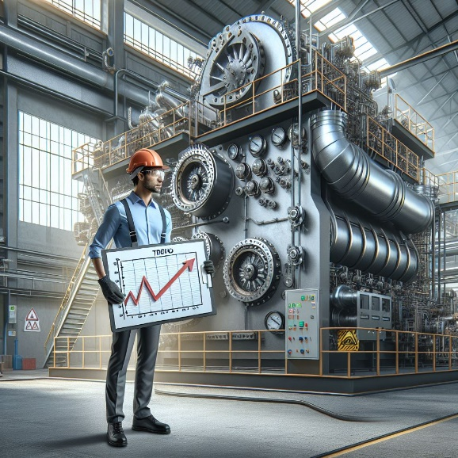
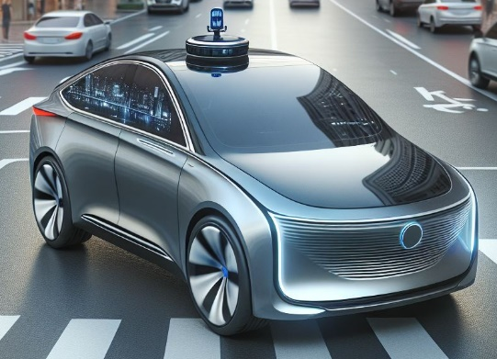
Types of Predictive AI / ML
Vision Systems
Anomaly Detection
Prediction
Non-logo images created from Copilot
Notes:
This can replace manual and repetitive tasks, but requires us to have the data to help train it ahead of time.

Slide 11
What’s next for AI?
ASI: Artificial Super Intelligence in ~2030s (1000s of days)
We are stuck in the Matrix ~2050
AGI: Artificial General Intelligence in 2025/2026
If Sam Altman is right…

Slide 12


Expanding the hierarchy
Artificial General Intelligence
Self-aware & consciousness
Abstract reasoning & problem solving
Transfer knowledge
Understand context
Emotional intelligence
AGI = Humans
Artificial Super Intelligence
ASI >> AGI = Humans
Notes:
Key characteristics include:
Self-awareness and consciousness
Abstract reasoning and problem-solving
Ability to transfer knowledge between domains
Learning from minimal examples (like humans)
Understanding context and nuance
Emotional intelligence and social cognition
Unlike Artificial General Intelligence (AGI), which aims to match human cognitive abilities, ASI would exceed them, potentially developing its own consciousness and emotions.

Slide 13
What’s next for AI?
ASI: Artificial Super Intelligence in ~2030s (1000s of days)
We are stuck in the Matrix ~2050
AGI: Artificial General Intelligence in 2025/2026
If Sam Altman is right…
Let’s consider if AGI & ASI is decades+ away
By scaling Predictive AI, companies can rejuvenate pre-2022 AI, driving substantial value and process optimization today (without fear of the Matrix!)

Slide 14
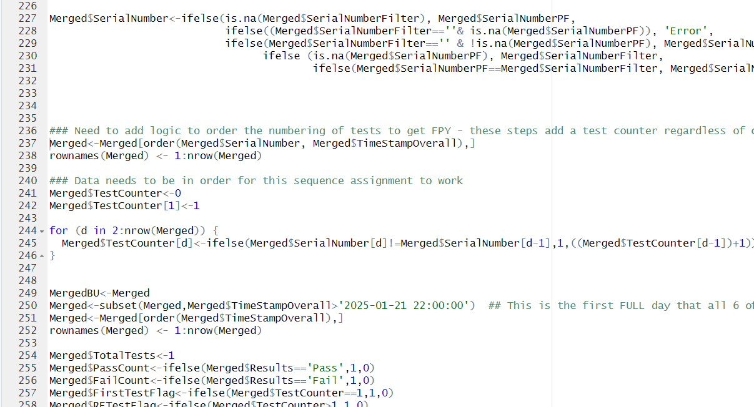

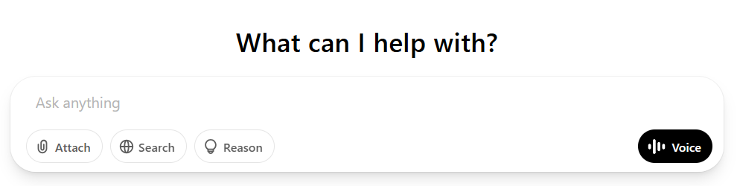
Challenge of Predictive AI compared to Gen AI

Slide 15
First Key Takeaway
Understand the difference and applications of Gen AI compared to Predicative AI / ML
They create value in different ways

Slide 16
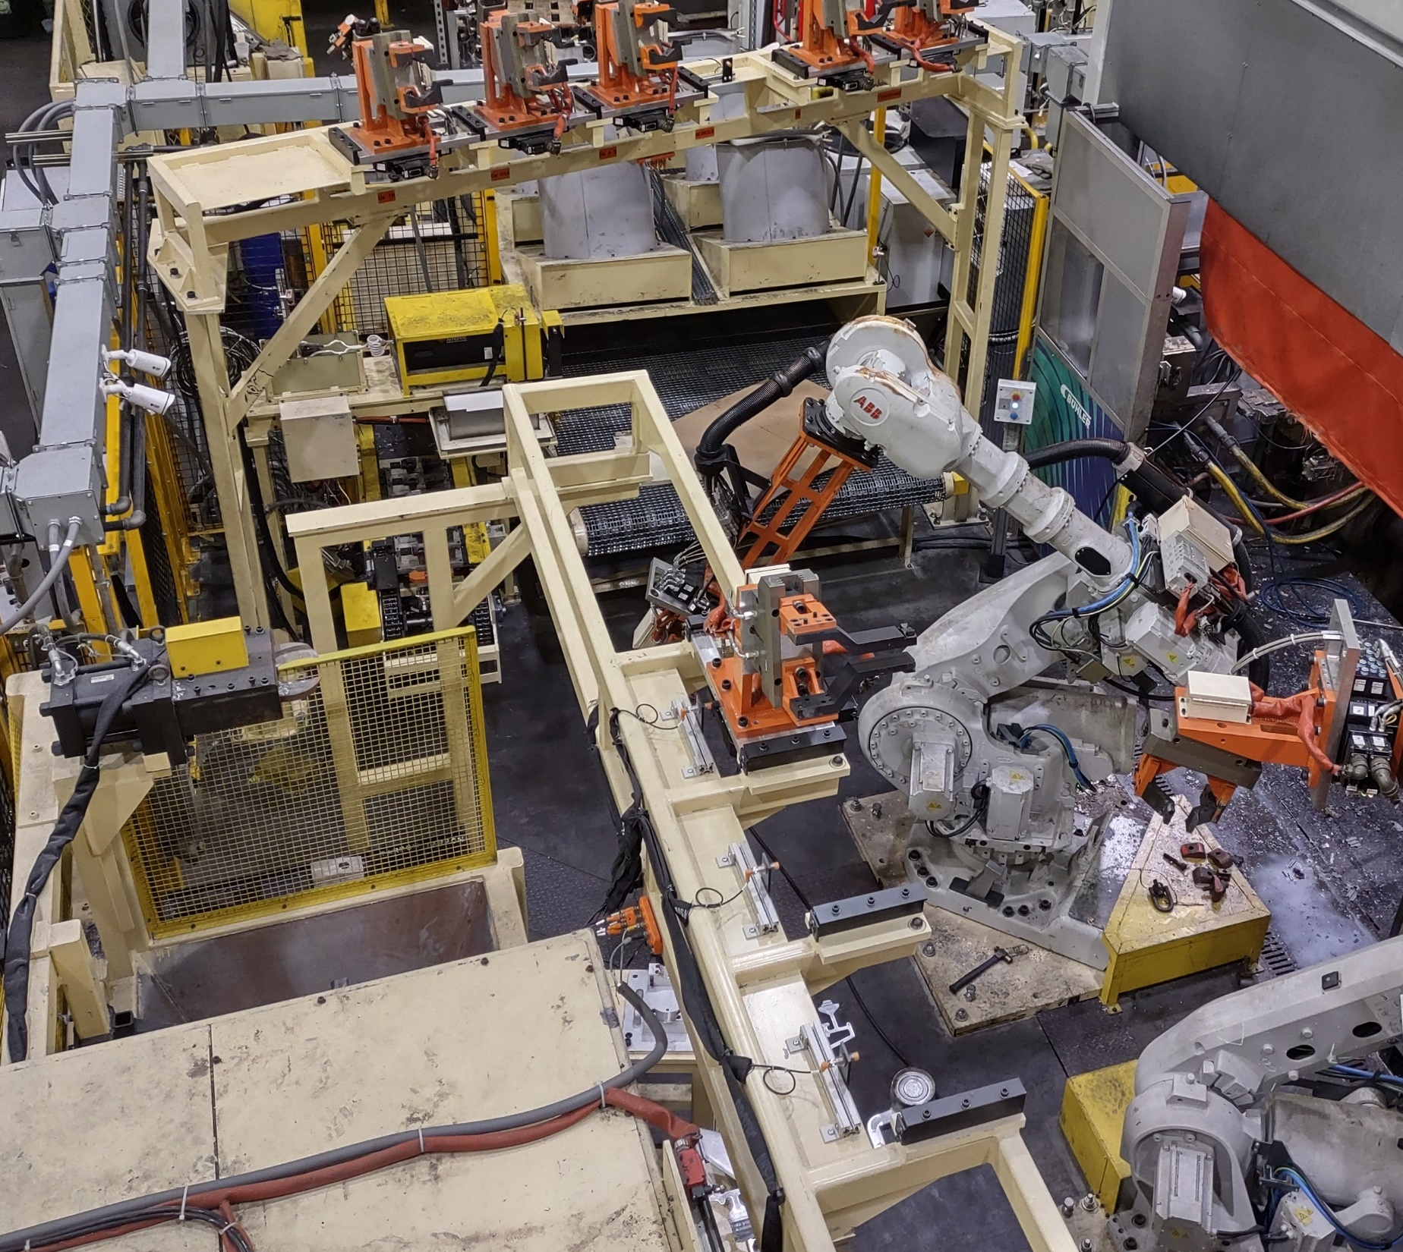
What does this have to do with manufacturing?

Slide 17


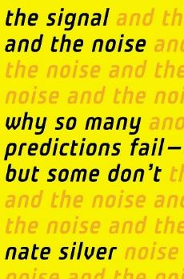




Notes:
I tell you all this history to give you a better understanding of my perspective, but to also highlight there are two things I really care about:
Manufacturing
Using data to improve manufacturing
The hype cycle on AI got out of hand –every app, device, or thought is now powered by AI -- AI toasters!!! The simple prompt makes it all seem like magic…. Many people just do not understand it.
Have learned many lessons within manufacturing, that I believe are useable beyond MFG

Slide 18
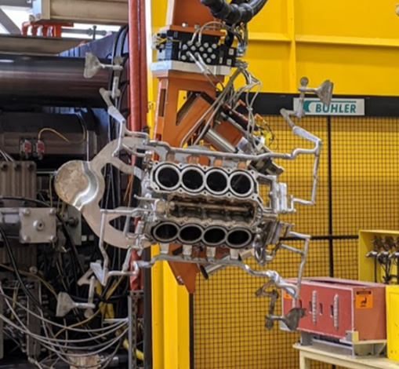


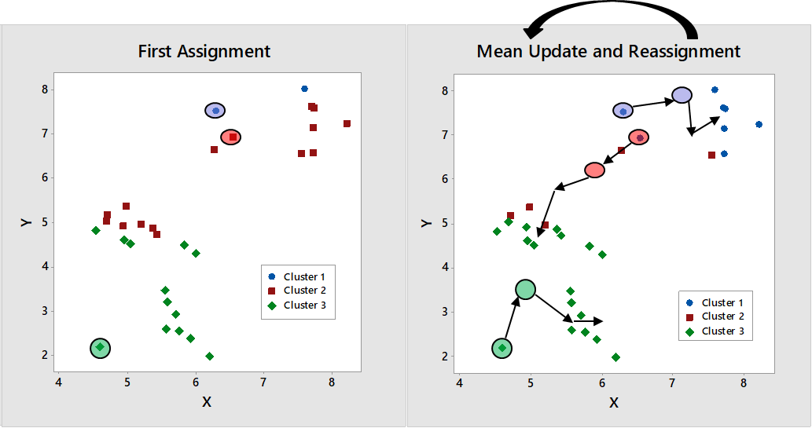
Initial
ML
Project (2016)

Slide 19



Obvious data gaps to scale ML sent me down the path of Industry 4.0 (I4.0)
Mechanization
& Steam
1st Industrial Revolution
A quick history
Electricity & Assembly Lines
2nd Industrial Revolution
Computers
& Robotics
3rd Industrial Revolution

Slide 20

Obvious data gaps to scale ML sent me down the path of Industry 4.0 (I4.0)
I4.0 leverages interconnected networks and advanced technologies to create intelligent, data-driven, connected factories that enhance employees’ decision-making processes in manufacturing
Technologies
People
Data

Slide 21
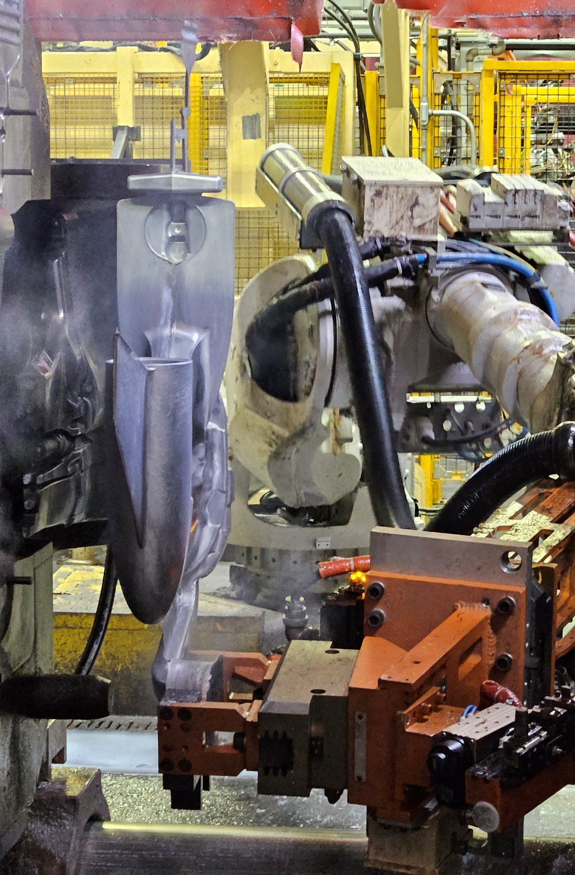
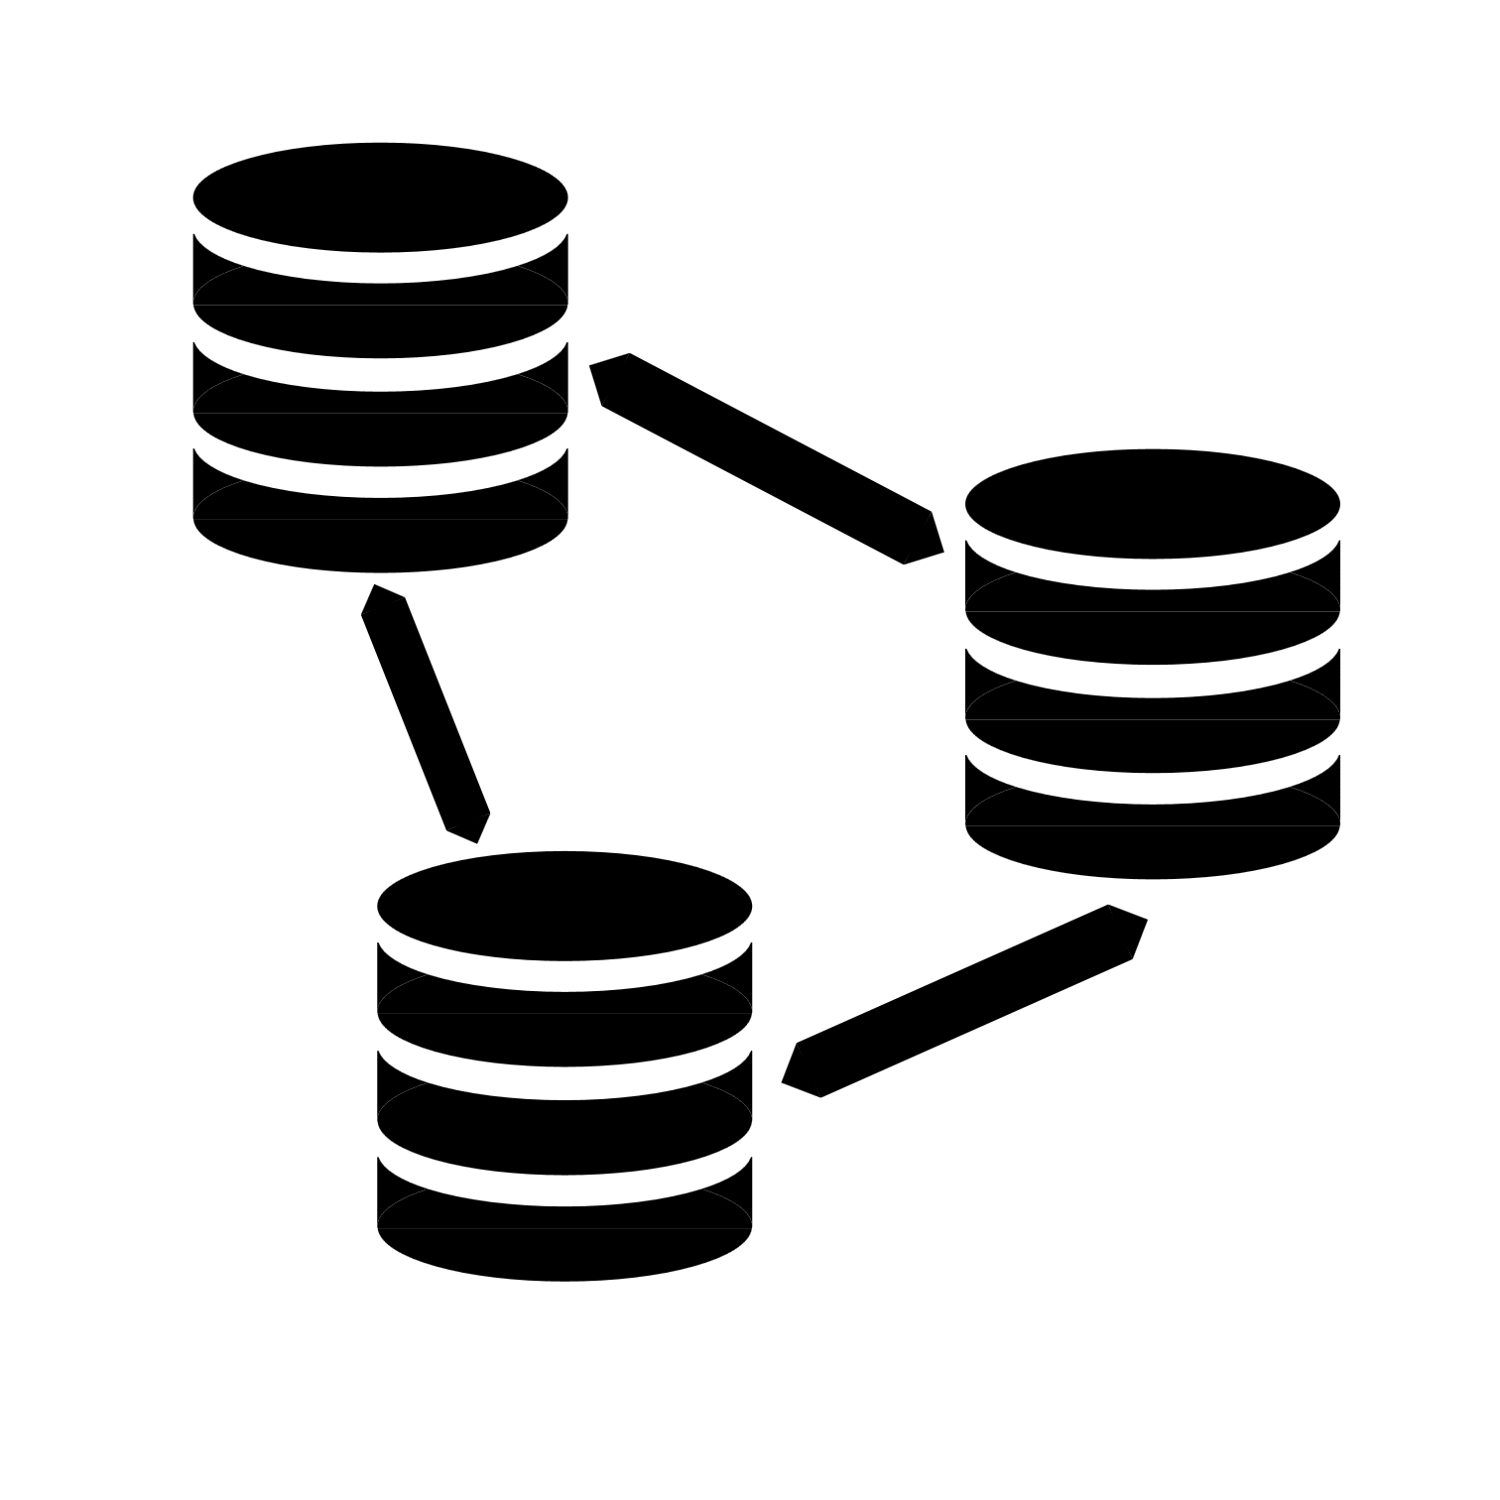
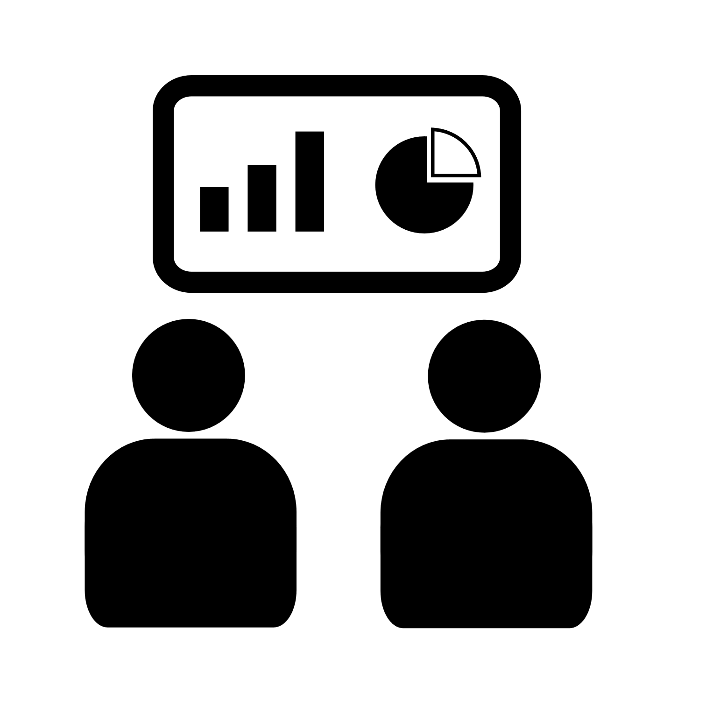
The next challenge was implementing I4.0
Connect
Collect
Consume

Slide 22

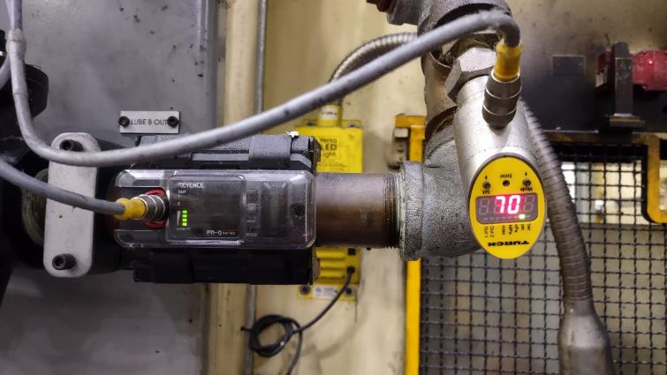
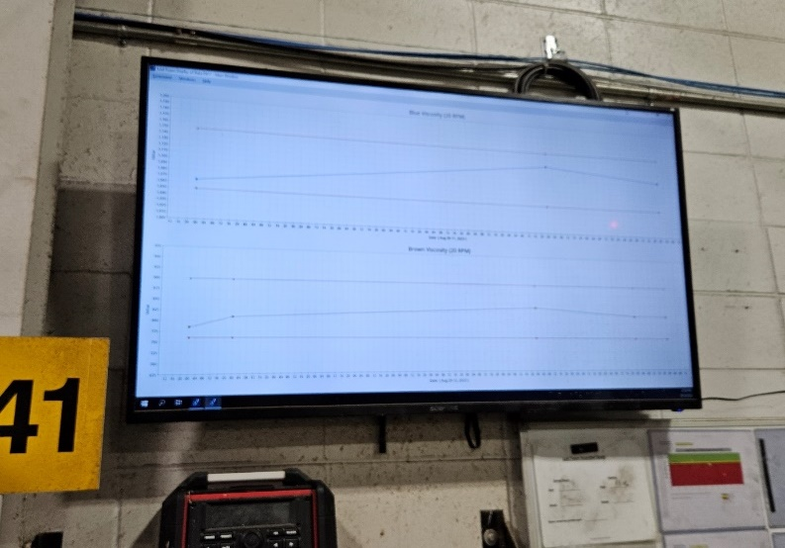
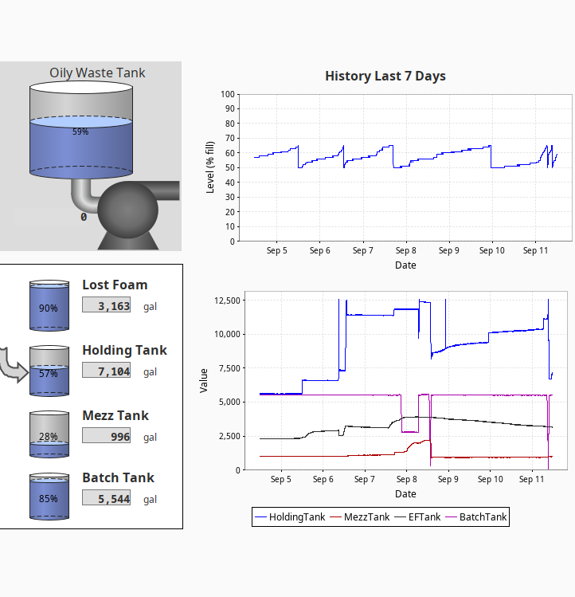
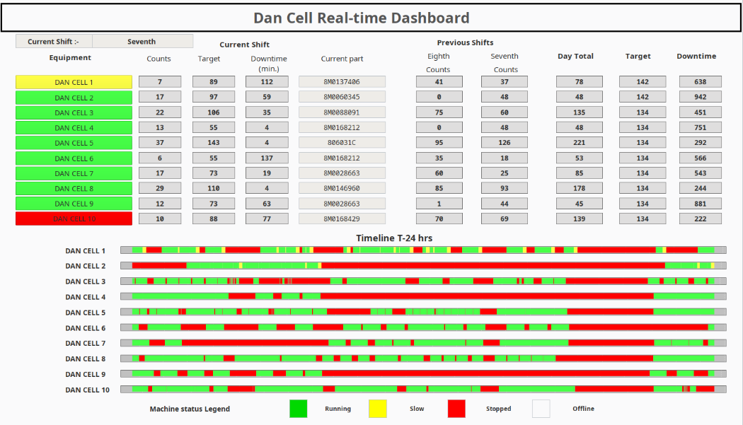
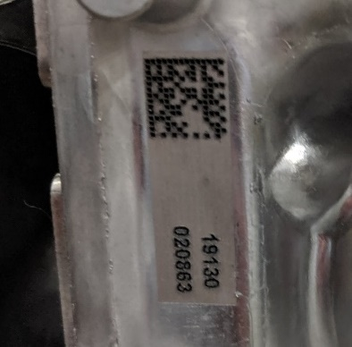
Mercury’s Connected Operations Team

Slide 23

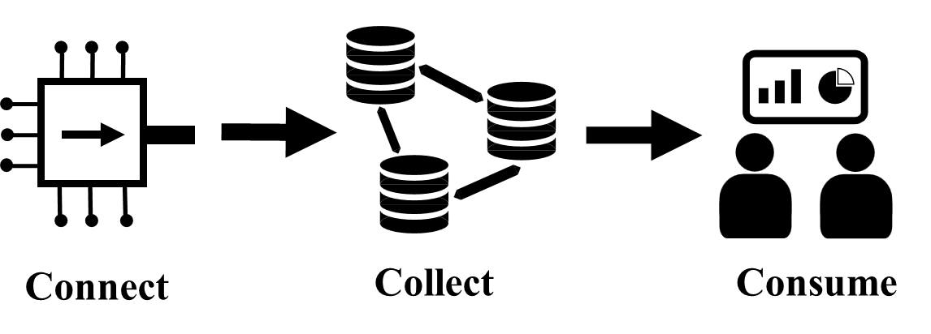
It was my data ‘Field of Dreams’ moment …
… except not everyone came to the data game
Image created from Copilot

Slide 24
Human element of I4.0 became clear
Supervisor Pushback
“I don’t believe the data”
“That’s not the info I needed”
“This does not solve our biggest problem”
Notes:
I don’t have time to review this…
This isn’t the right data

Slide 25

In hindsight, this should not have been a surprise
Image created from Copilot (notice the car in the mirror is driving backwards down the highway ☺)

Slide 26

Many people in manufacturing have made successful careers making decisions with a lack of data or information.
Having the data available completely changes the game.

Slide 27
Technical Aspects
Human Aspects
Hardware & sensors
Equipment connections
Communication protocols
Data & databases
Software & automation
Understanding the problem being solved
Team alignment
Change management
Training & education
Culture around data

Slide 28
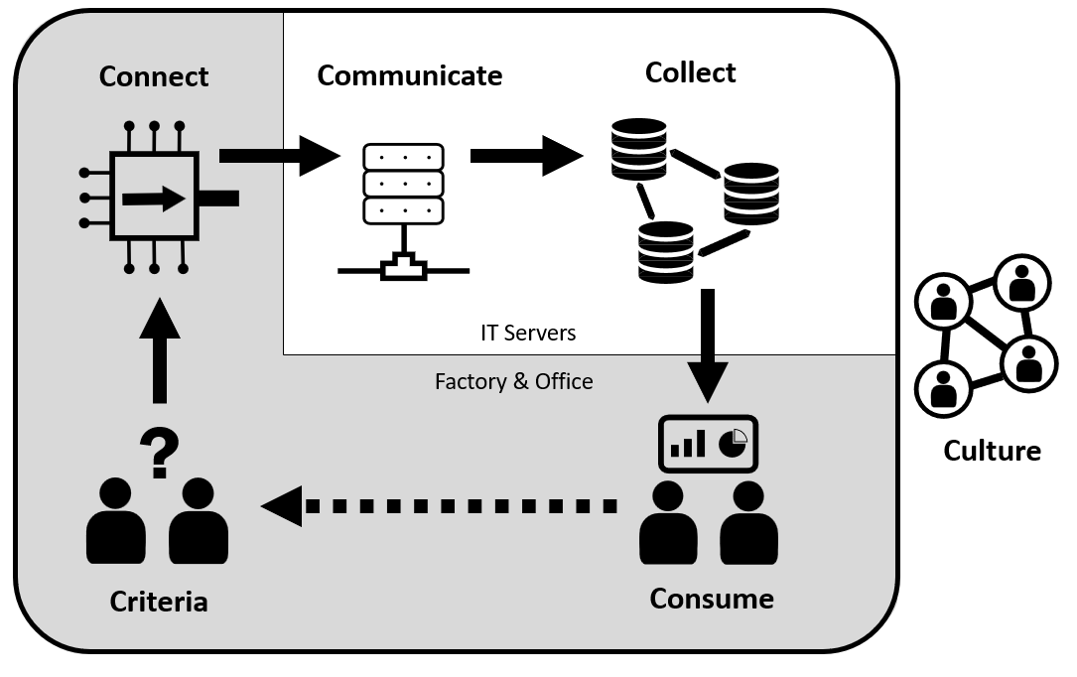
6C Framework for Connected Manufacturing

Slide 29

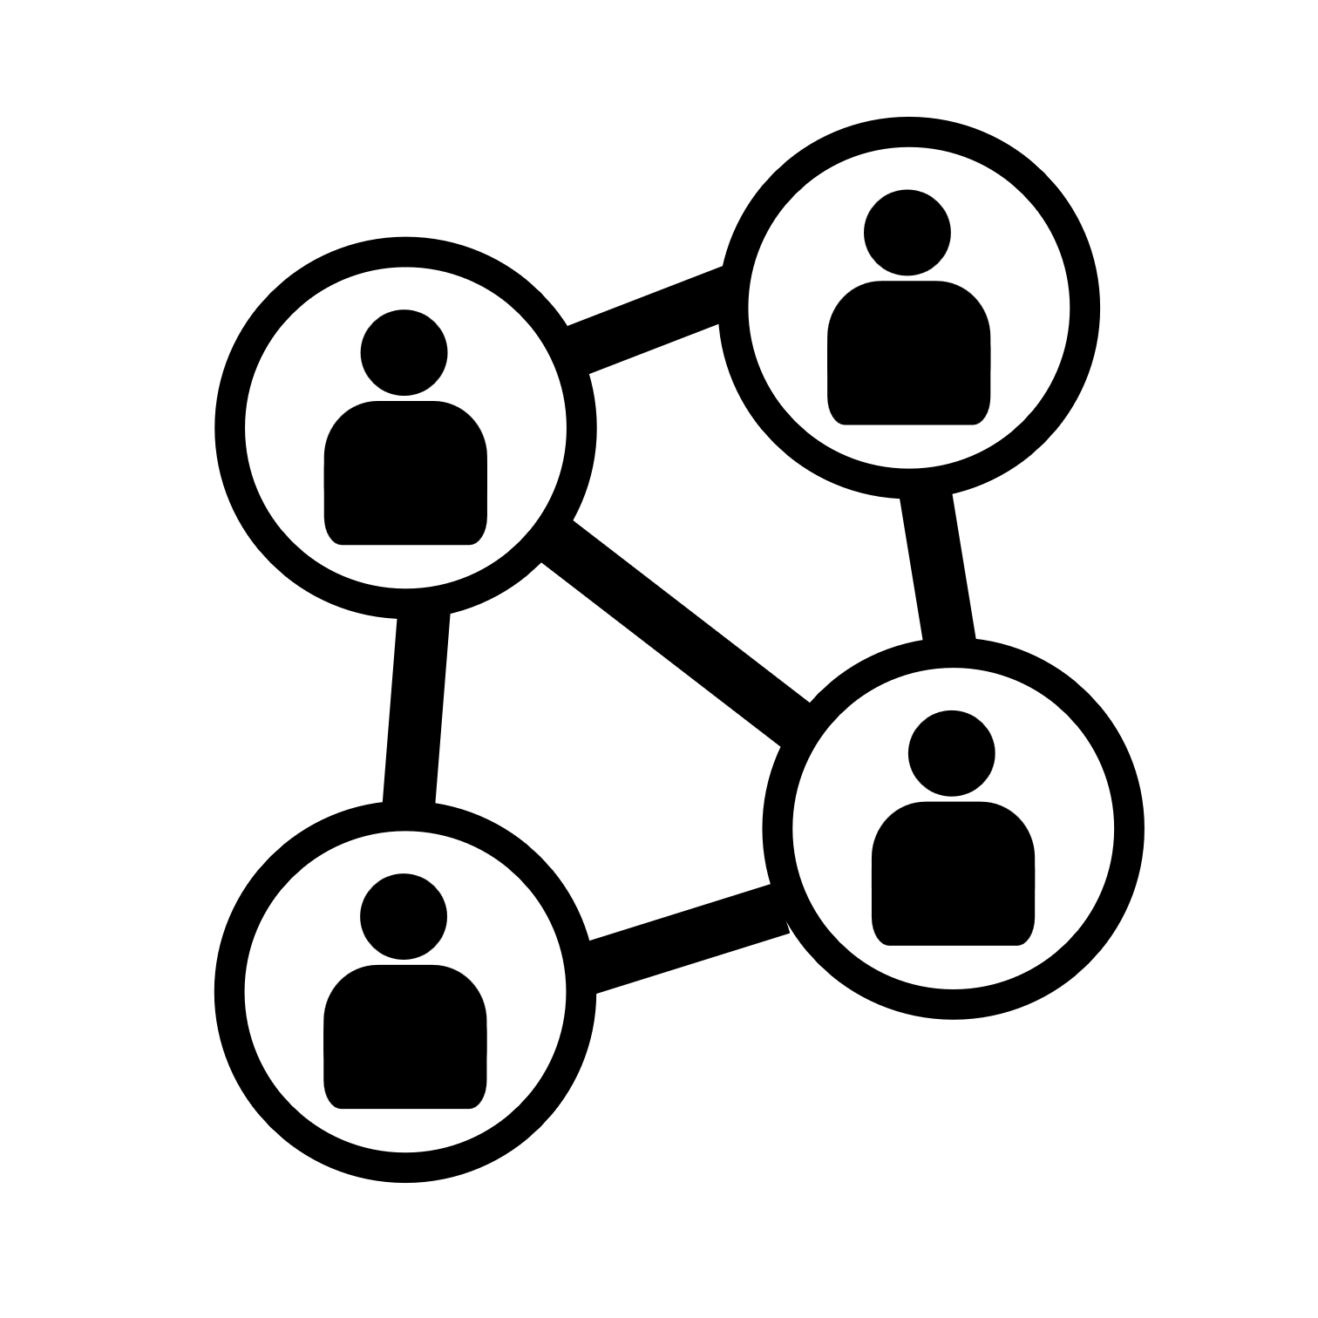

I4.0 6C framework parallels AI
Create /
Coordinate
Collect
Coach AI
Culture
Criteria
Consume

Slide 30
Technical aspects are known
Create /
Coordinate
Collect
Coach AI
Culture
Criteria
Consume

Slide 31
The balance is difficult …
Create /
Coordinate
Collect
Coach AI
Culture
Criteria
Consume

Slide 32
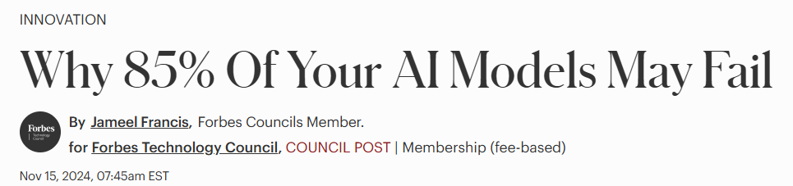

Forbes Article from November 2024
85% of all AI models/projects fail because of poor data quality or little to no relevant data
https://www.forbes.com/councils/forbestechcouncil/2024/11/15/why-85-of-your-ai-models-may-fail/

Slide 33



Conversation at a Conference:
AI chatbot to aid in trouble-shooting for maintenance
Do you have good trouble-shooting documentation?
Do you have good WO notes captured?
Can you interview your best mechanic?
Can’t we just use AI to do this all?
I finally understood the artificial in AI

Slide 34
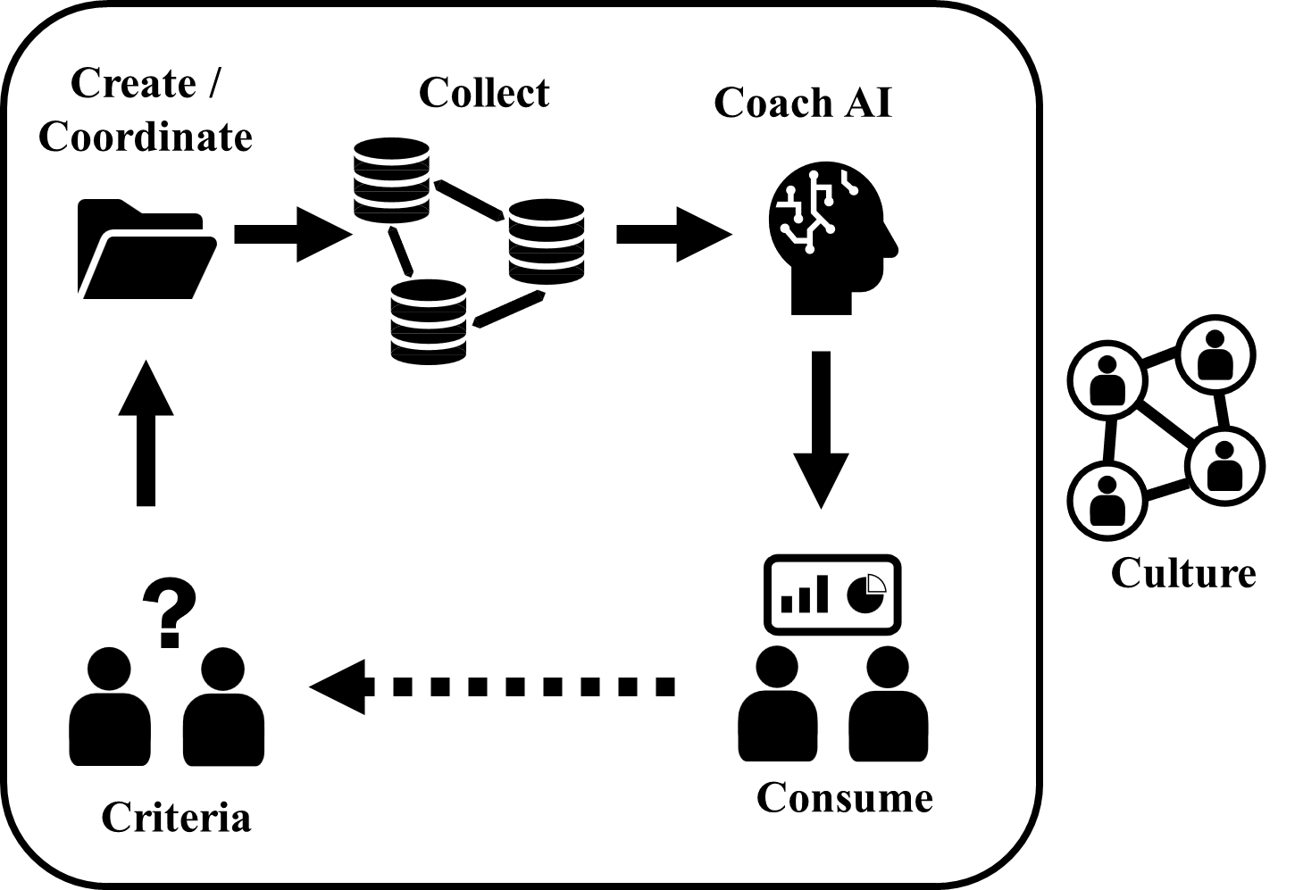
The magic of prompting has (for some) distorted the understanding needed to be successful with AI
First human problem: understanding the need and data

Slide 35
Using data is hard - Will people give up autonomy and control?
Second human problem: creating a culture to use and consume AI

Slide 36
Second Key Takeaway
People and culture play a critical role in the implementation and utilization of AI
Is your organization currently discussing strategies to address cultural issues of AI alongside technical challenges?

Slide 37
What’s next in AI?

Slide 38
What’s next in AI?
I do not believe we really know

Slide 39
What we do know:
AI is a complex technology – understand the applications
Adapting to AI and data will require changes in people’s roles
High-quality data is essential to AI success
Implementing change in people is challenging and requires a plan – it will not just happen

Slide 40



Code for my email
Questions?
David.Blondheim@mercmarine.com

Slide 41
Abstract
Industry 4.0 (I4.0) is revolutionizing manufacturing by integrating advanced technologies and amplifying the critical role of data. This transformation necessitates the synergy between people, technology, and data to obtain Operational Excellence within organizations. Achieving these improvements requires a balance between the human and technical aspects of data and analysis.
The 6C Framework for building a connected factory offers a roadmap for data collection and use in manufacturing. The framework’s principles extend beyond the manufacturing sector, providing valuable insights for any organization working with data and analytics. This presentation will explore the 6C Framework, focusing on the essential interplay between human and technical elements in leveraging data for organizational success.

