Slide 1
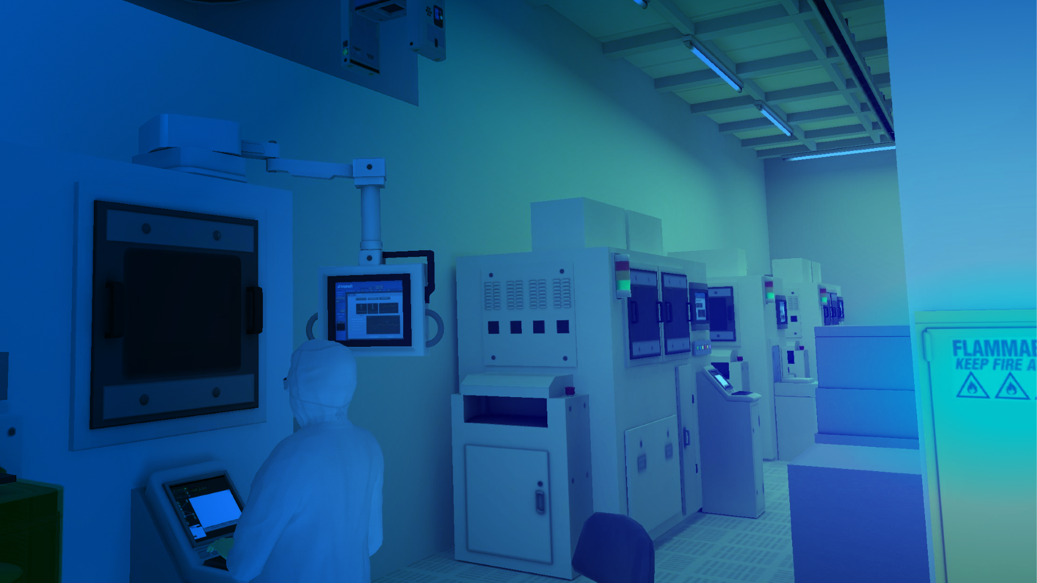
Introducing Transfr
From Classroom to Career
01/12/2025
Notes:
Sim in background version

Slide 2
Agenda
Introductions
Overview of Transfr
Transfr Simulation Experience
Questions

Slide 3
How did you explore careers as a student?

Slide 4
What is Transfr?
Our Solution
Our Mission
Transfr delivers real world training simulation experiences in a digital environment that’s safe and cost effective.
Transfr has assisted learners engage and explore career pathways that lead to career satisfaction.
Grew to serving customers in 3 to 48 states in less than three years
“We want to help every student, tradesperson, and job seeker develop in-demand skills, secure long-term employment, and enjoy upward mobility.”
Recent Awards
v
v
v
Bharani Rajakumar,
CEO, Transfr
Fastest Growing Businesses
2024

Slide 5
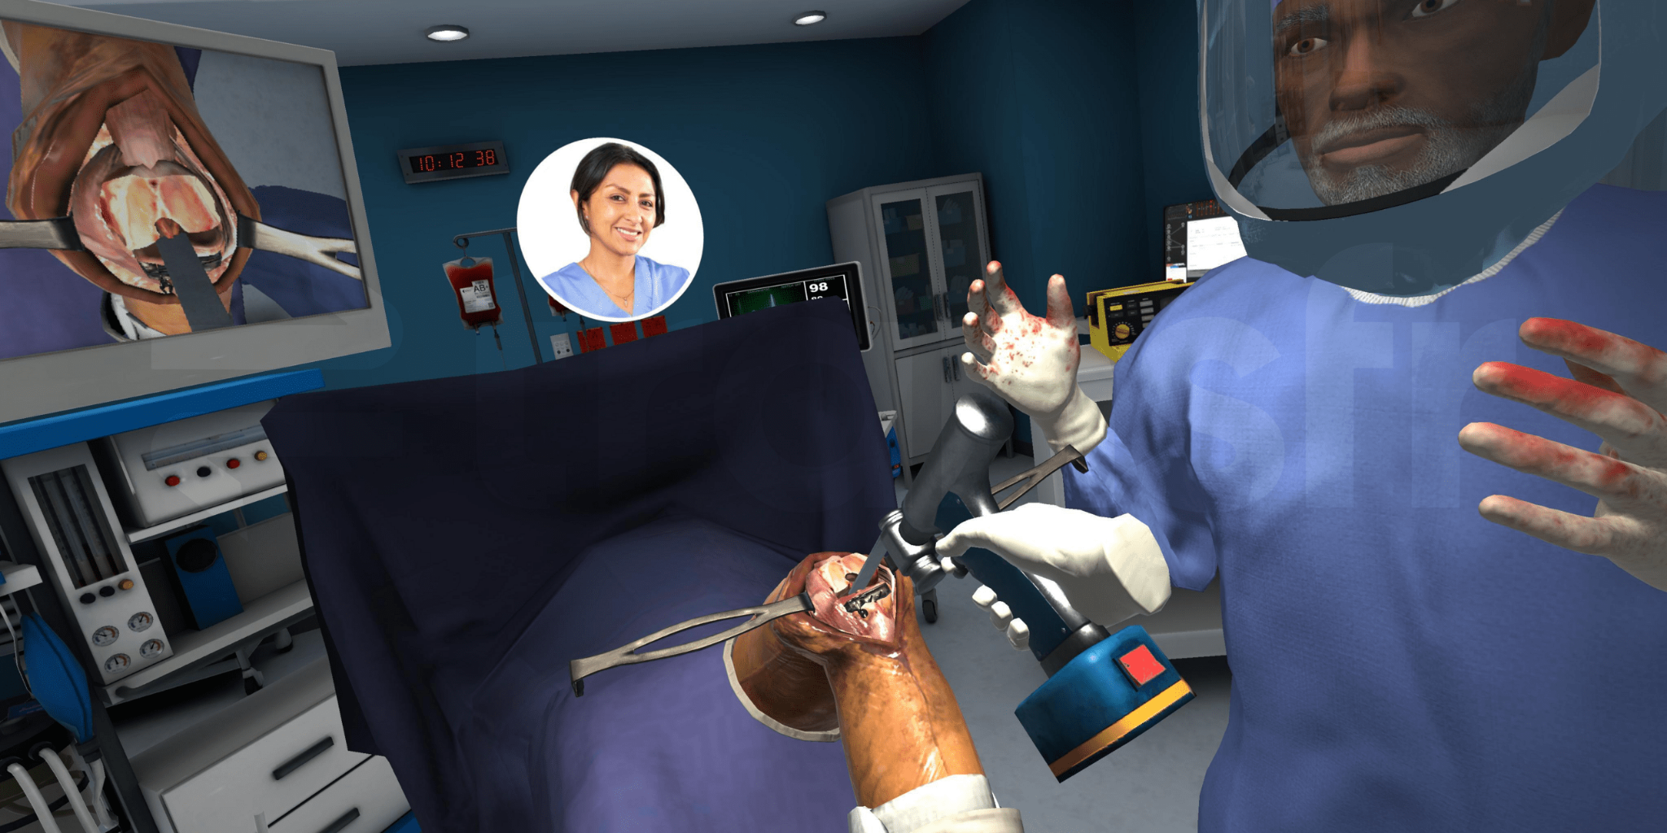
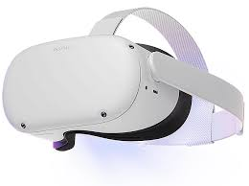
3 Takeaways
Flexibility
Hands-On Experience
Digital Coach

Slide 6
Supporting the Classroom-to-Career Pathway
Career Awareness
Career Exploration
Career Preparation
Career Training
Career Placement
Discover Careers
Experience a Career
Develop Foundational Skills
Train for a Career
Join the Workforce
Our VR-based Skills Training aligns to national standards set for safety, measurement, and other foundational skills such as OHSA, Precision Measurement, and more.
With 300+ VR simulations in 8 high-growth sectors, our Skills Training enhances career programs or offers turnkey Pre-Employment solutions
NEW! Transfr Trek’s mobile experience has 100+ careers in 16 career clusters with robust planning tools.
32 VR simulations enable an individual to experience a day in the life of a career, available with CC and in Spanish.
With the skills and confidence to succeed, start the journey to upward mobility!

Slide 7
30+ Occupations to explore in Transfr
Experience a day in the life of each role
Architecture & Construction:
Broadband Utility Construction*
Broadband Tower Technician *
Broadband Technician, Fiber *
Transmission Line Worker *
Distribution Line Worker *
Construction Laborer
Solar Technician *
Electrician*
Pipefitters*
Carpenter
Finance:
Financial Analyst - NEW!
Information Technology:
Network Technician*
Manufacturing: Semiconductor Manufacturing Technician*
EV Battery Manufacturing Technician
Industrial Maintenance Technician
Robotics Specialist
Welder*
Health Sciences:
Radiologic Technologist - NEW!
Surgical Technologist*
Registered Nurse*
Pharmacy Technician
Medical Assistant
Law, Public Safety, Corrections
& Security
Emergency Medical Technician*
Transportation, Distribution & Logistics:
Airframe and Powerplant Technician
Electric Vehicle Service Technician
Automotive Service Technician
CDL Truck Driver- NEW!
Agriculture, Food
& Natural Resources
Diesel Farm Equipment Mechanic- NEW!
Hospitality & Tourism: Restaurant Manager - NEW!
Chef - NEW!
Arts, A/V Technology, & Communication:
Graphic Designer - NEW!
* = available in Spanish
Notes:
*Chrissy Present

Slide 8
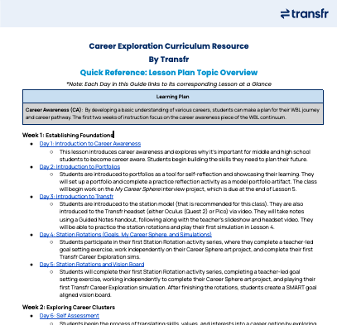
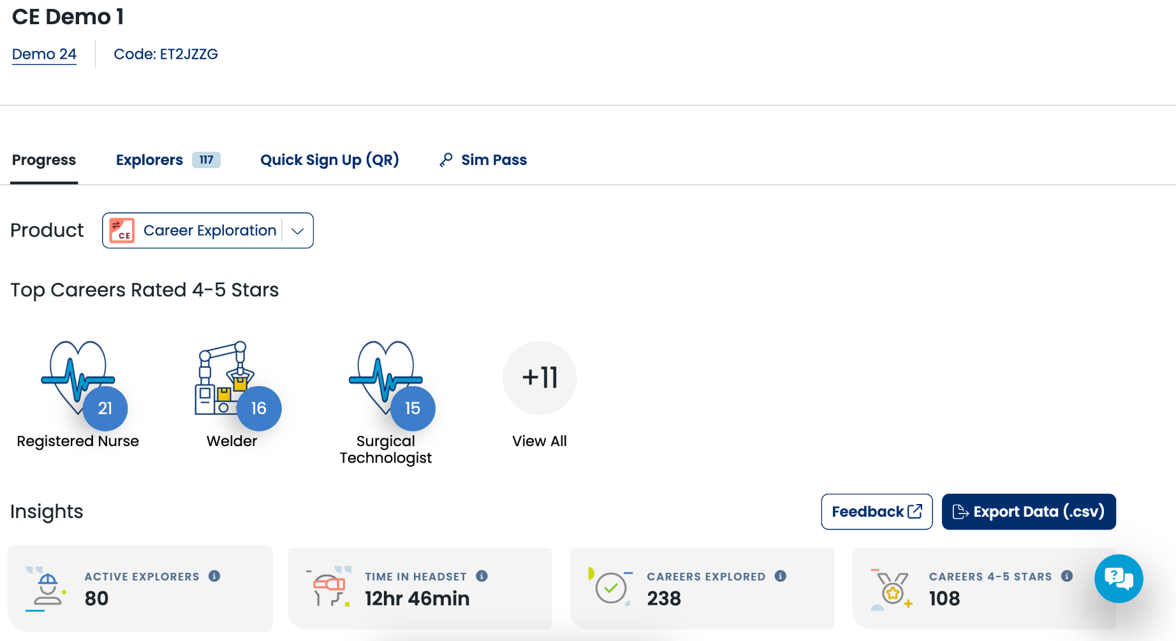
Transfer Trek | Career Exploration

Slide 9
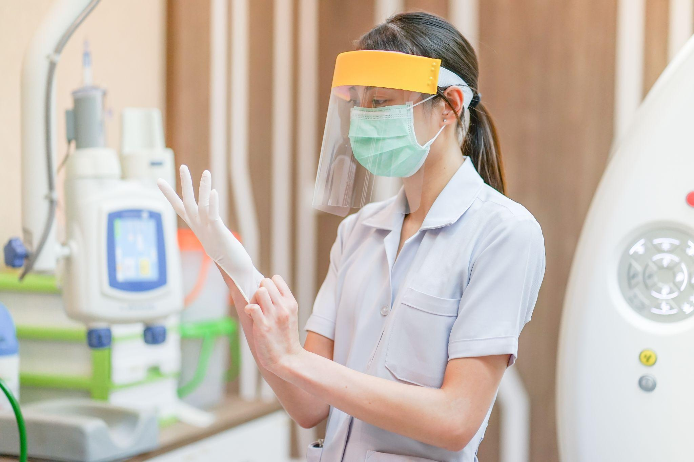
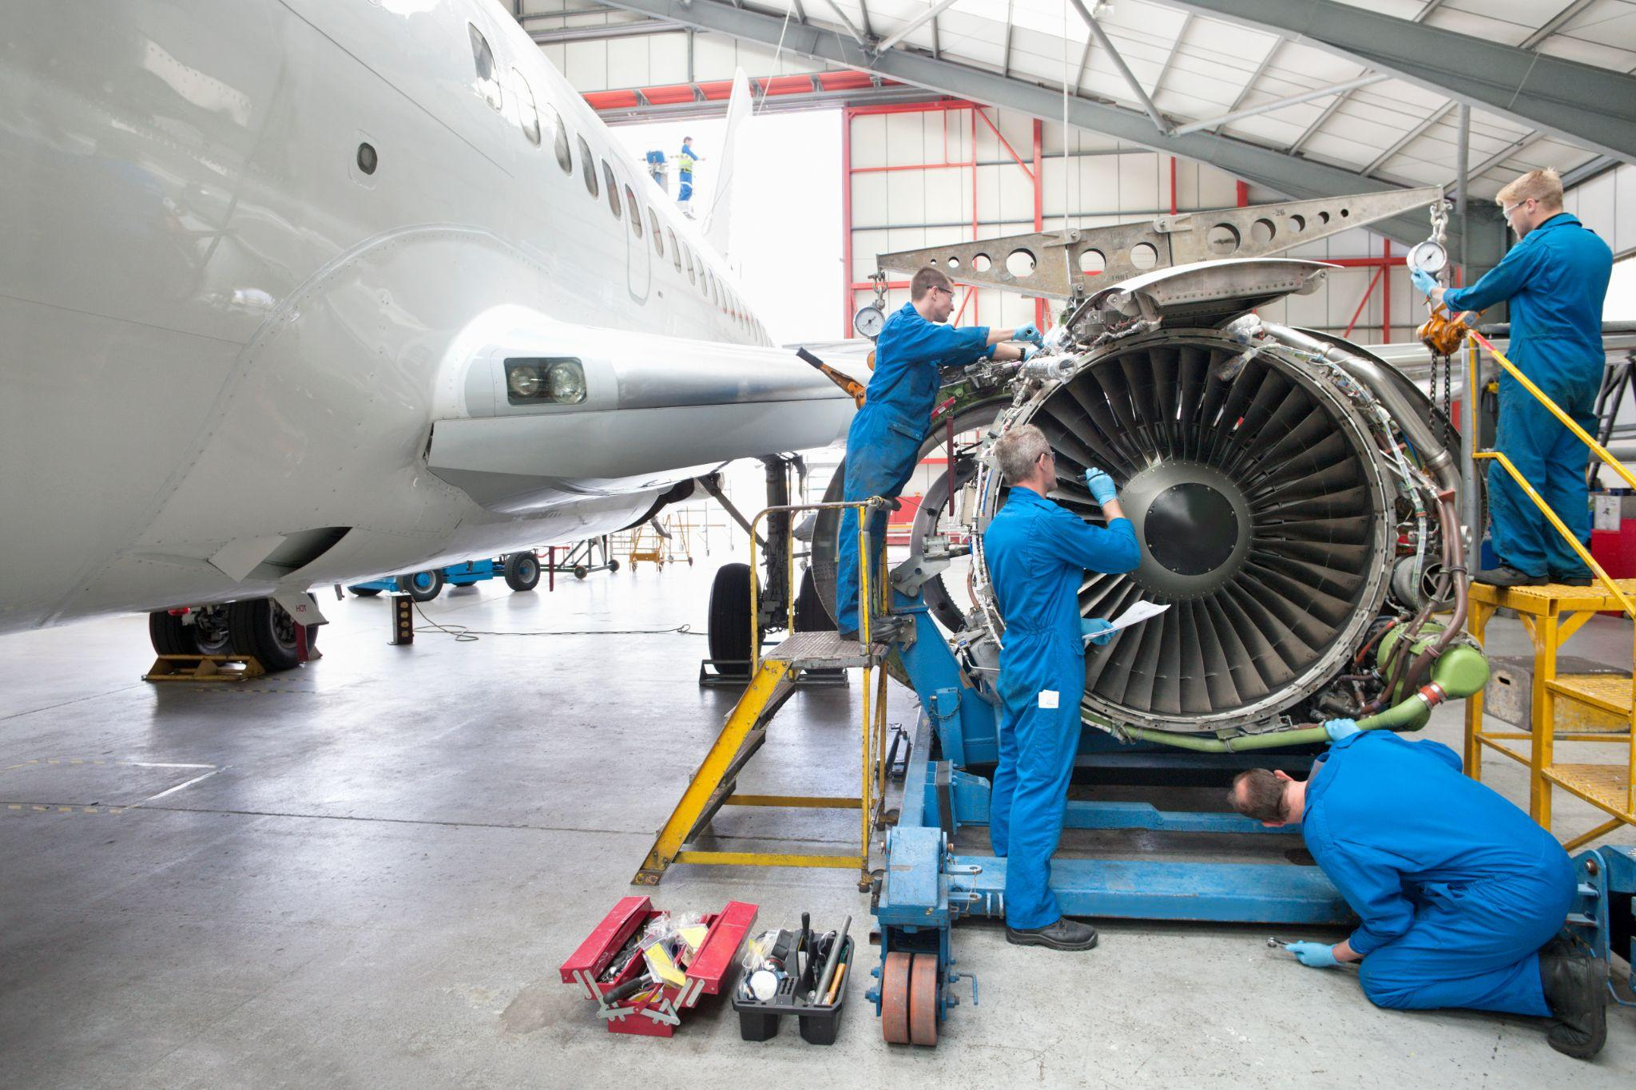
Virtual Training Facility
In a safe, virtual environment, and under the expert guidance of Simon, our digital mentor, learners practice the skills they need to get hired for well-paying jobs.
330+ training simulations for 8 of the fastest growing job sectors
Automotive
Construction
Healthcare
Aviation Maintenance
Diesel Technology
Manufacturing
Electrical Construction
Hospitality & Tourism
Click the link below to learn more about our sims!
Virtual Training Facility
Notes:
Virtual Training Facility has over 300 simulations across various industries and disciplines. Schools, colleges, non-profits, and local government entities utilize the virtual training facility to teach skill mastery to their students and job seekers within their programs, to learn critical job skills to ultimately help them get placed in a job with an employer.
Transfr has simulations in the nation’s top industries that you can see here, including curricular alignment to various industry standards and national certifications such as MSSC (Manufacturing), NCCER (Construction), OSHA (Safety), and more, from our various subject matter experts on staff. There’s a link to our full product catalog so you can dive into the details after this call!

Slide 10
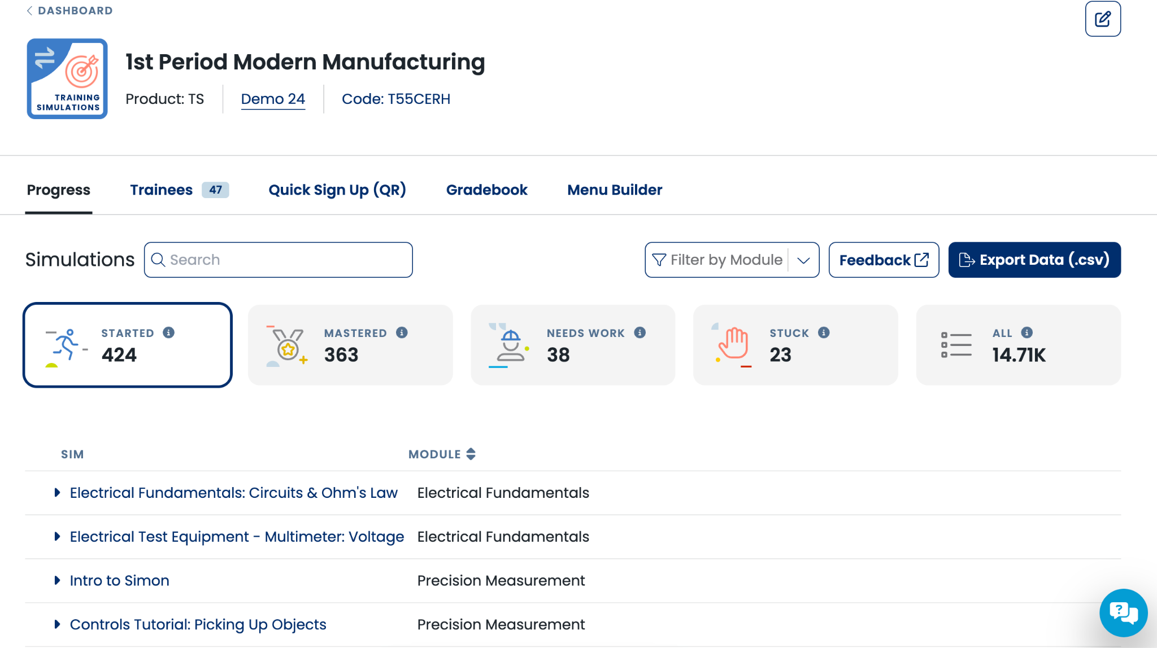
Dashboard Analytics | Training Facility

Slide 11
How does Transfr compare to how you explored careers?

Slide 12
Transfr Improves Learning Outcomes
Learner
Engagement
Skill Performance
Learning Retention
60% more on-task
90% of learners achieve mastery
2x higher learning recall
work was reported from trainees when learning via Transfr sims compared to traditional lectures.
on their first attempt using Transfr simulations
compared to traditional learning, regardless of gender, income, and age.
Notes:
We support recruitment, enrollment & persistence to IRCs. We can deliver on outcomes that increase your federal funding allocation.

Slide 13
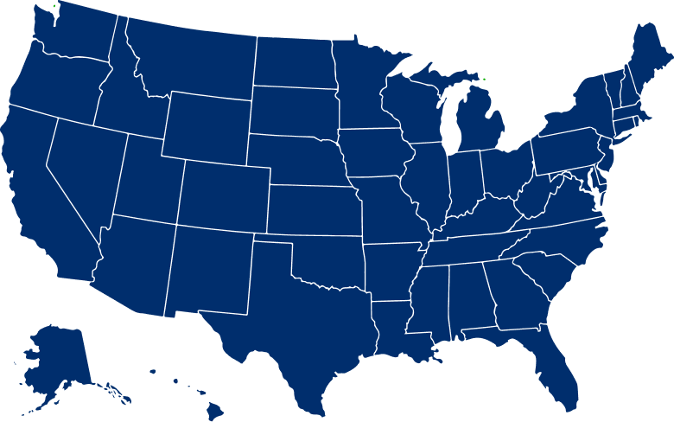
We’re The Leader in Immersive Learning
By the Numbers
48
827
STATES
IMPLEMENTATIONS
50K
800K
LEARNERS SERVED
SIMS EXPERIENCED
K-12
Higher-Ed
Government
Fortune 1000
Markets We Serve
Community Organizations
Workforce Development Groups

Slide 14
QUESTIONS?
AJ Villarreal
State Workforce Manager
avillarreal@transfrvr.com
630.247.3352
Pat Salstrand
State Workforce Manager
psalstrand@transfrvr.com
320.249.9160

